Slide 1
Eco Leaders
Celebration of the Word

Slide 2
What part do the Eco Leaders play in making our school a better place for the environment and you?
Think about others in this school and how we litter. It doesn't just have to be in school - you can think about how we can do it at home and in the neighbourhood.

Slide 3
What we are aiming for this year
We will be taking a visit to the Rosary - the elderly home -
We will be changing the lights to LEDs to save money and for a better environment.
We will be planning a day where we walk to the park instead of driving as it is better for the air.
Walk to or most of the way to school.

Slide 4
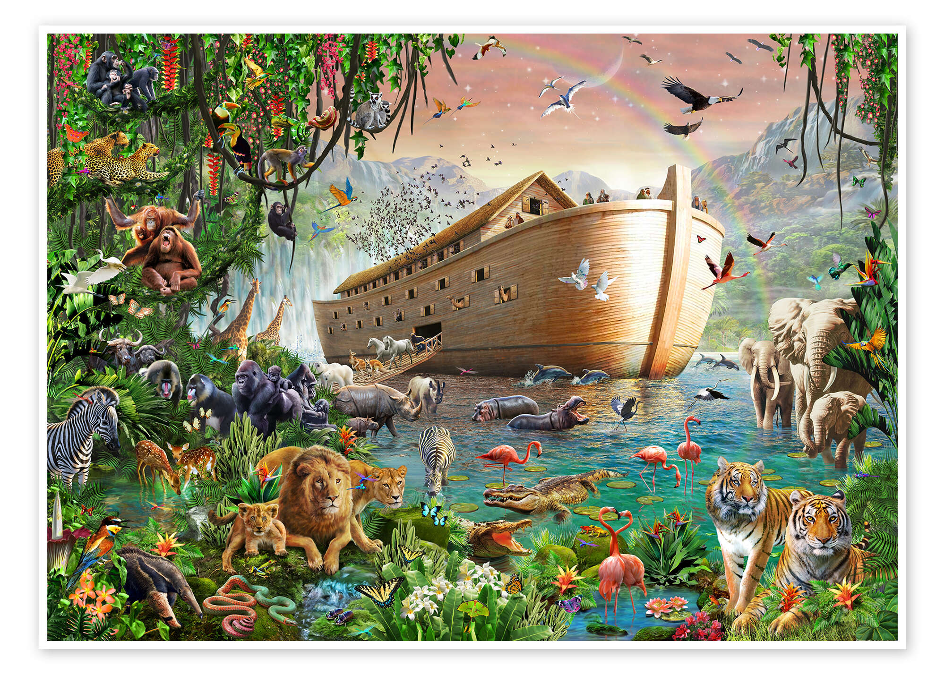
Genesis chapter 8 verses 1-13

Slide 5
How do you think this scripture links to the Eco Leaders?

Slide 6
Act of Faith prayer
O my God,
I believe in you and in all.
That your Holy Church teaches because you have said it and your word is true.
You are the Christ, the Son of the living God.
You are the Lord and my God.
Lord, I believe, increase my faith.
Amen

Slide 7
Laudato Si

Slide 8
Our Father
Our Father
Who art in heaven,
hallowed be thy name, thy kingdom come thy will be done on earth
as it is in heaven
give us this day our daily bread and forgive us our tresspasses.
As we forgive those who trespass against us,
And lead us not into temptation
But deliver us from evil
Amen

Slide 9
Thank you for listening

